Slide 1

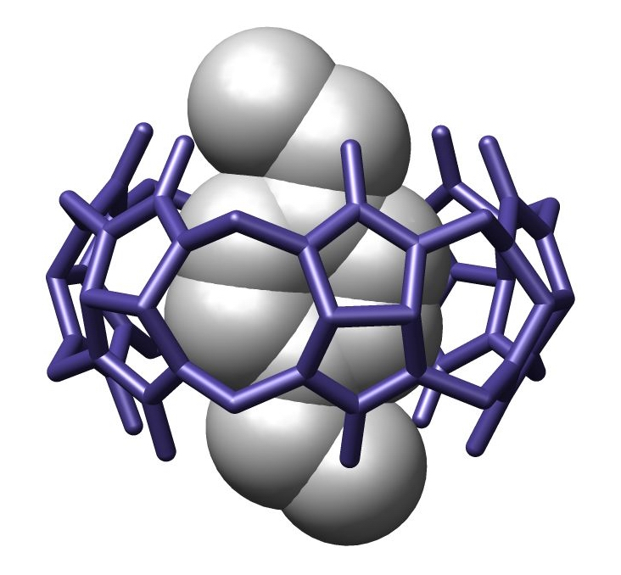
University of Crete
Department of Chemistry
Molecular encapsulation
Agapaki Eleni, 1048
MSc Subject: Metallomacrocycles & Supramolecular Chemistry
Scientific Supervisor: Athanasios Coutsolelos
Spring Semester, 2019-2020

Slide 2
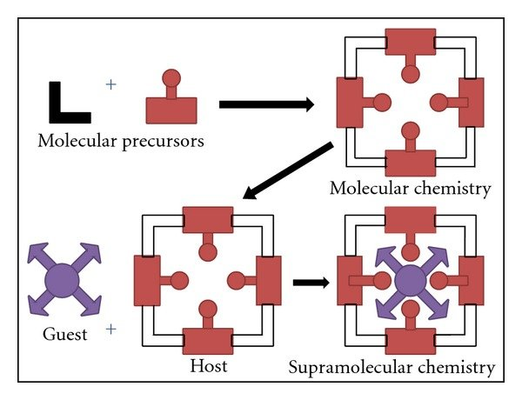
Outline
What is molecular encapsulation
Type of bonds
Conditions in and out
Type of hosts
Analyzation of hosts
Interesting applications

Slide 3
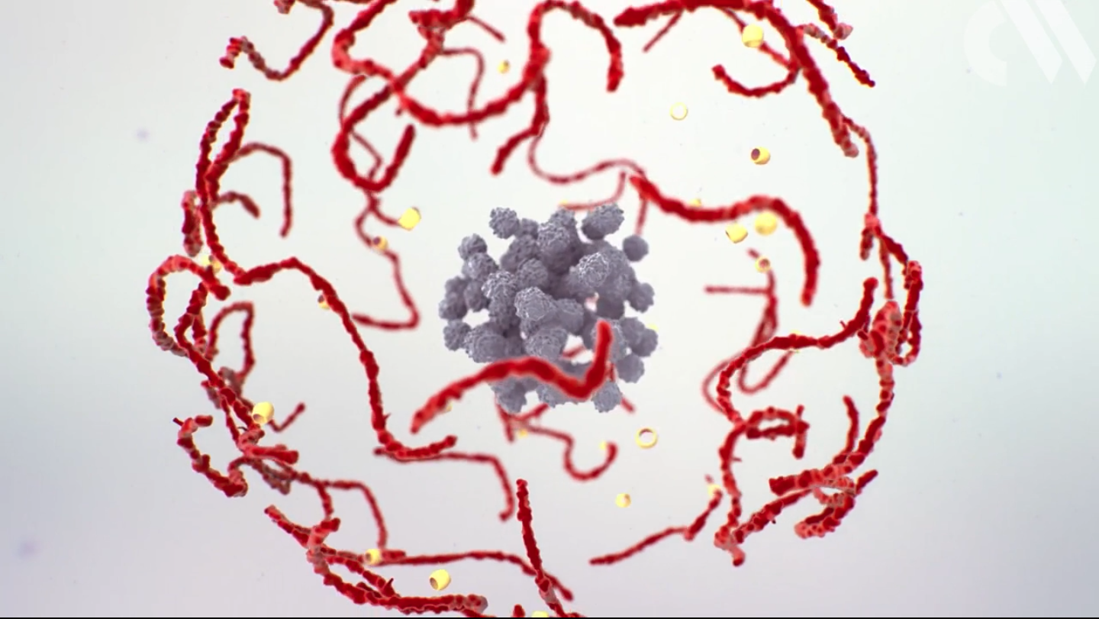
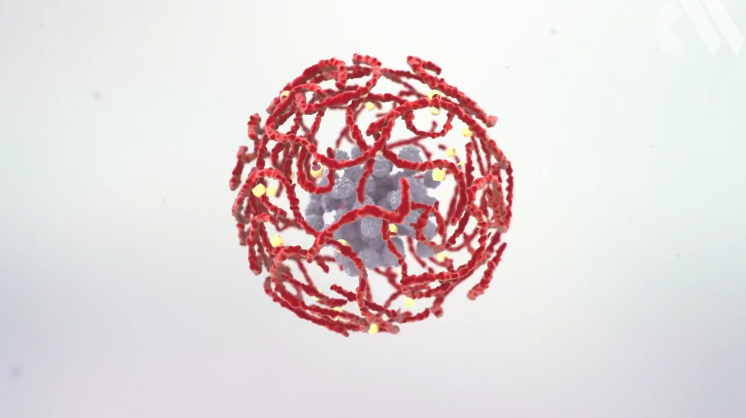
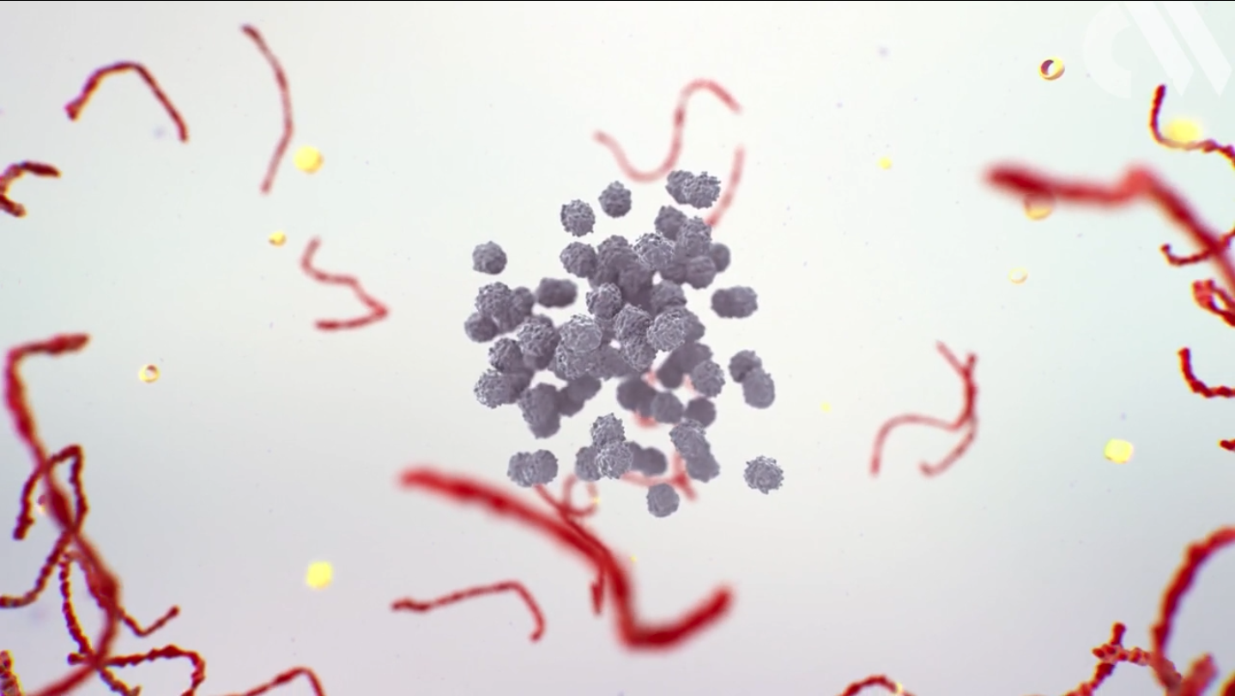
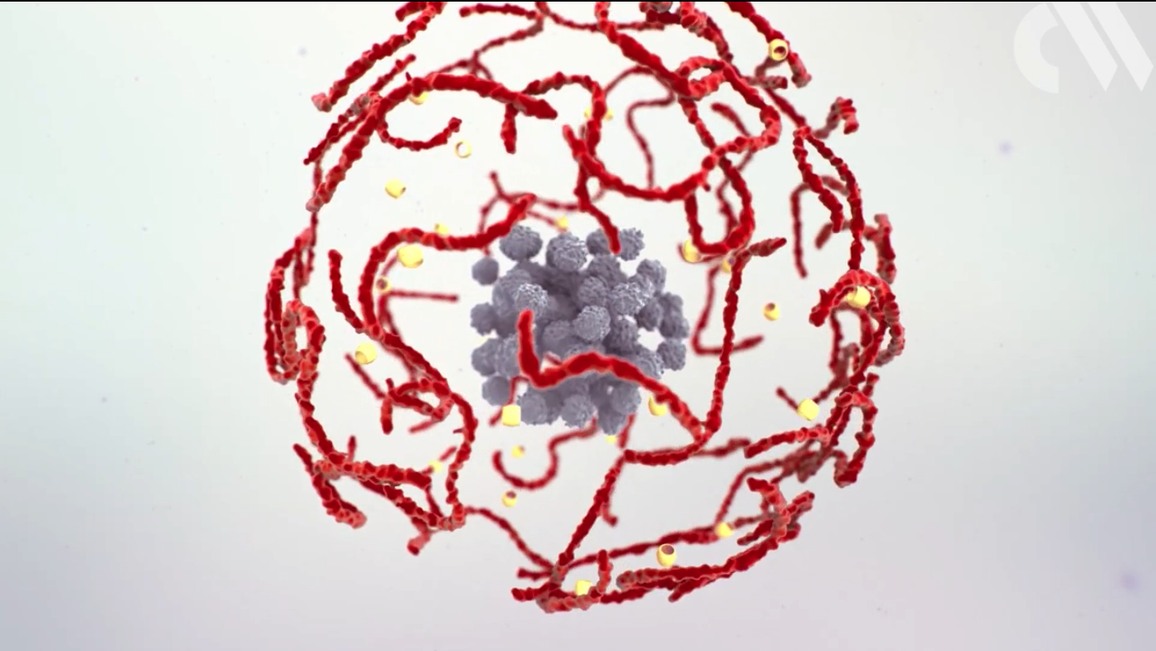
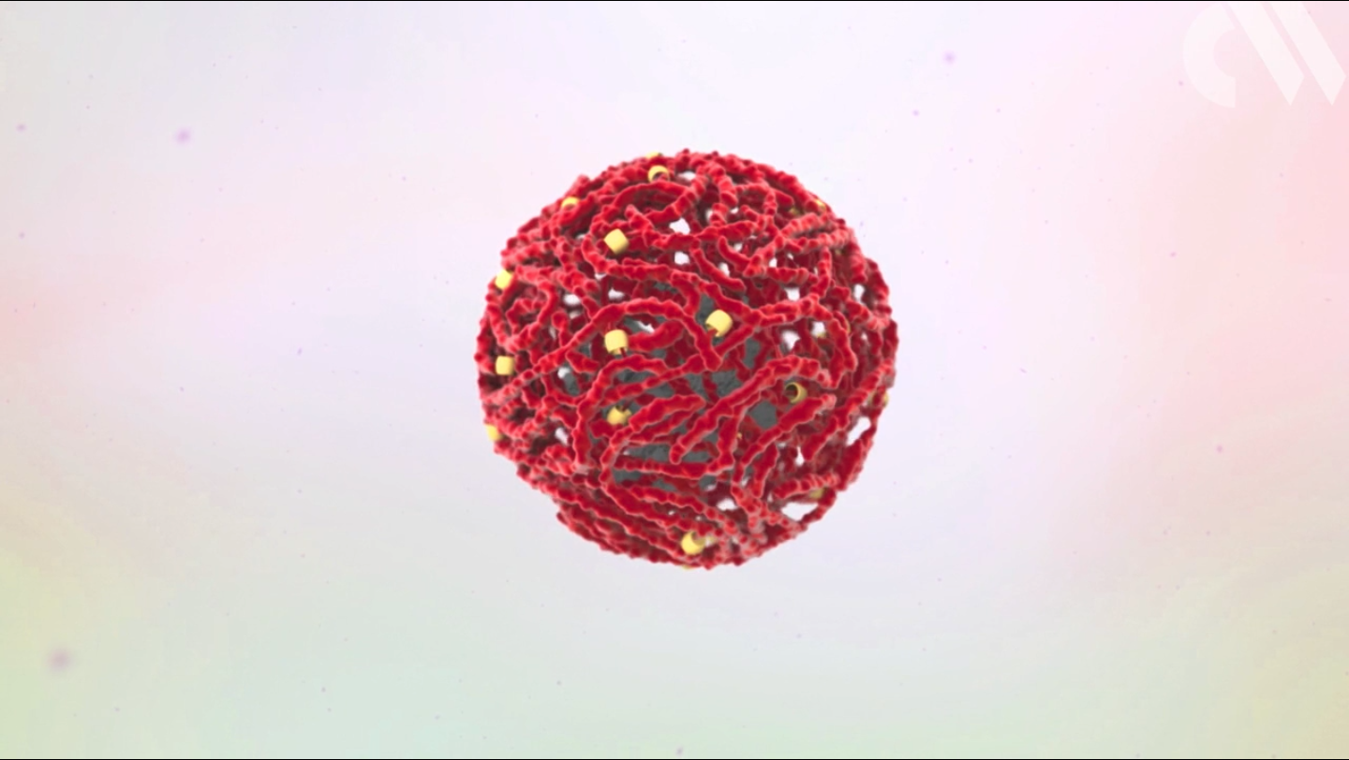
What is molecular encapsulation?
INTRO

Slide 4
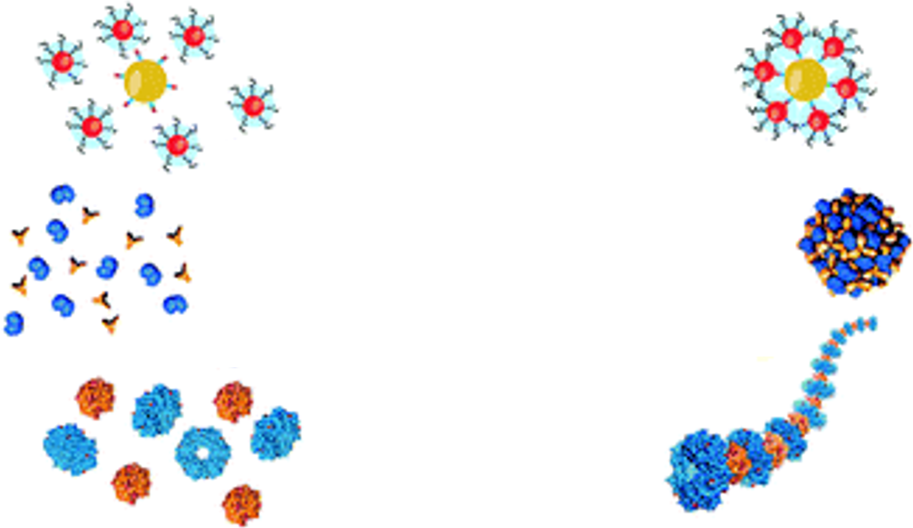
Sub-category of self assembly
A
Conditions: pH, temperature,ionic strength,concentration
of ligands
Self assembly
Interactions:
electrostatic,
hydrogen bonds,
Van der Waals,
π-π interactions,
hydrophilic-hydrophobic

Slide 5
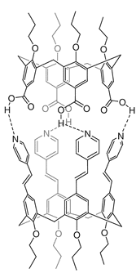
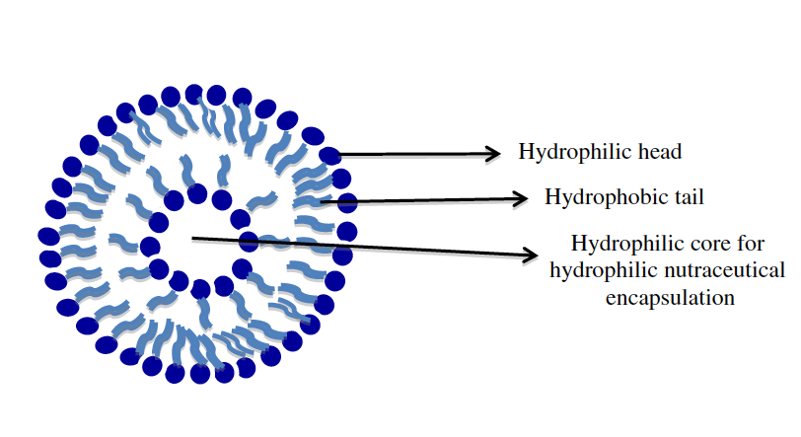
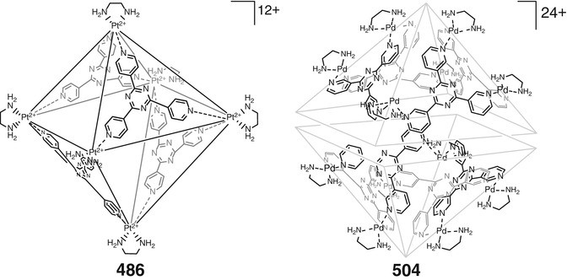
Bonds required in molecular encapsulation
B
Hydrophobic interactions
Van der Waals interactions
Hydrogen bonds
Metal co-ordination
Voloshin Y., Belaya I., Krämer R. (2016) Encapsulation by Hydrogen-Bonded and Other Supramolecular Capsules. In: The Encapsulation Phenomenon. Springer, Cham
N.P. Aditya, Yadira Gonzalez Espinosa, Ian T. Norton. (2017) Encapsulation systems for the delivery of hydrophilic nutraceuticals: Food Application
Sara Roosta, Sousa Javan Nikkhah, Mehdi Sabzali and Seyed Majid Hashemianzadeh. (2016) Molecular dynamics simulation study of boronnitride nanotubes as a drug carrier: from encapsulation to releasing

Slide 6
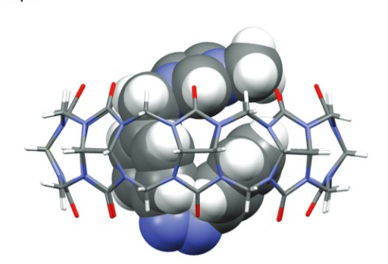
Characteristics of guest enclosure
C
Shape of guest
Cavity size
Surface of guest
Inner surface of the host

Slide 7
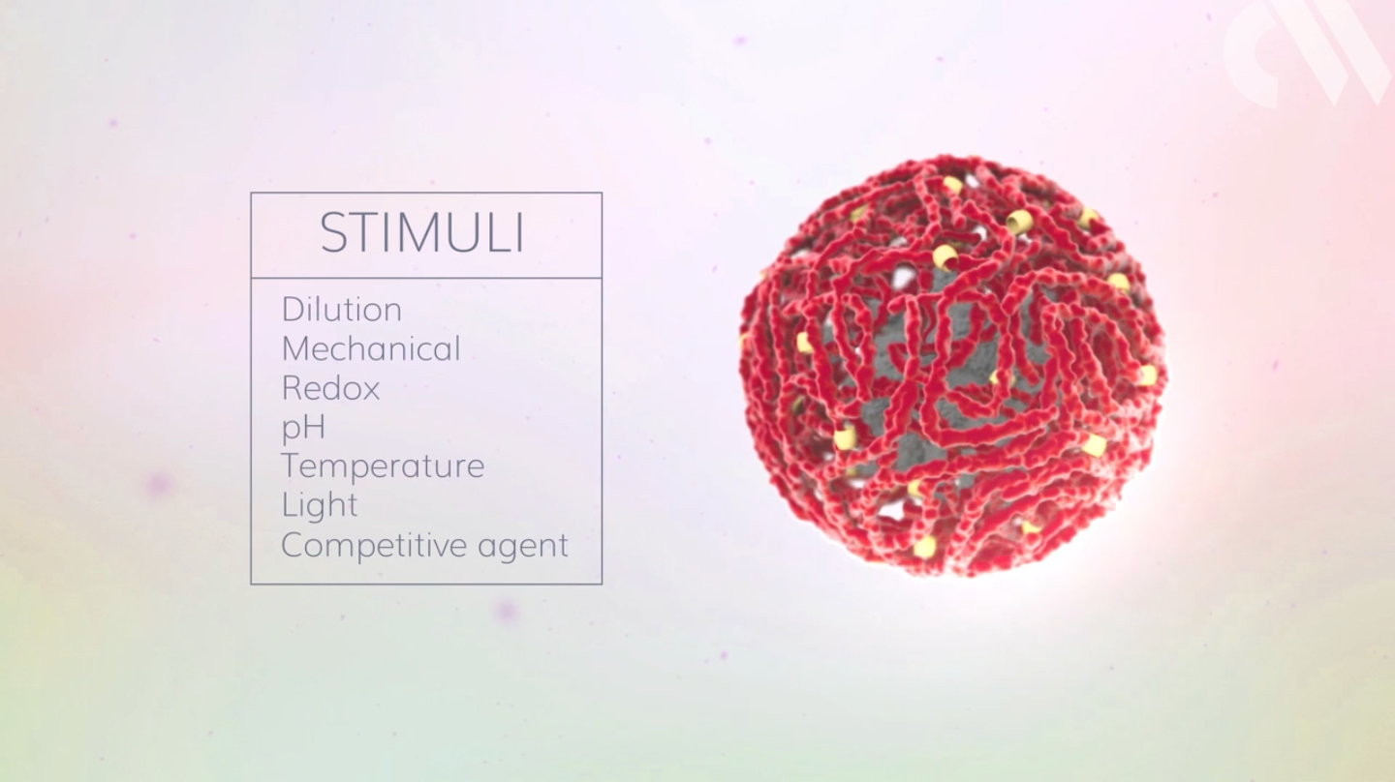
D
Conditions
https://www.chemistryworld.com/news/chemical-activity-on-demand/1017546.article

Slide 8
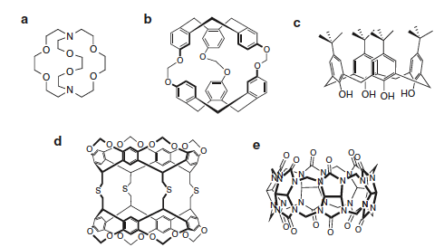
Types of Hosts
Molecules
Crown ethers
Cryptands
Cryptophanes
Calixarenes
Carcerands
Hemicarcerands
Cucurbiturils
Cyclodextrins
Pillarenes
Zeolites
MOFs
Dendrimers
Endohedral fullerenes
Structures of typical supramolecular hosts: (a) cryptand, (b) cryptophane, (c) calixarene, (d) carcerand, (e) cucurbituril.
Khaleel I. Assaf and Werner M. Nau. (2014) Cucurbiturils: from synthesis to high-affinity binding and catalysis
Grégorio Crini, Sophie Fourmentin, Éva Fenyvesi, Giangiacomo Torri, Marc Fourmentin, Nadia Morin-Crini (2018).Fundamentals and Applications of Cyclodextrins
http://www.chemvista.org/crownethers1.html

Slide 9
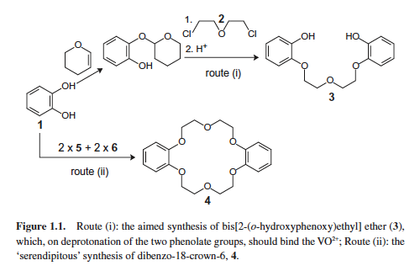
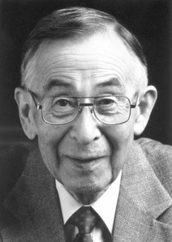
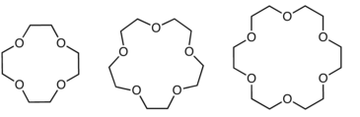
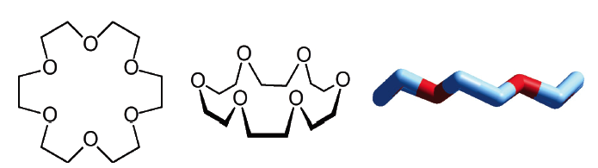
Crown ethers
similar to crowns
1967, Charles Pedersen, synthesized the first crown ether
birth of supramolecular chemistry
are cyclic chemical compounds
consist of a ring containing several ether groups (e.g. ethylene oxide)
have a hydrophobic exterior and a hydrophilic interior
encapsulate cations
the cavity size determines which cations can be encapsulated inside the cavity
the interactions between the cation and the crown ethers are purely electrostatic, that is through ion dipole attractions
increase the solubility of inorganic compounds in organic solvents to promote chemical reactions
K⁺
Li⁺
Na⁺
12-crown-4
15-crown-5
Charles Pedersen
18-crown-6
Luigi Fabbrizzi (Università di Pavia, Italy).(2018) Cryptands and Cryptates
https://en.wikipedia.org/wiki/Crown_ether#Azacrowns
http://www.chemvista.org/crownethers1.html
https://en.wikipedia.org/wiki/Charles_J._Pedersen

Slide 10
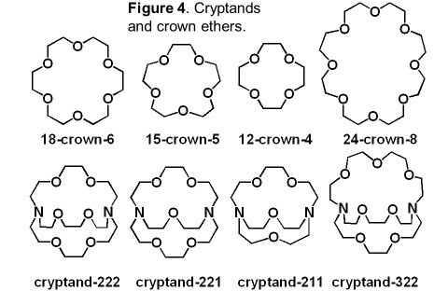
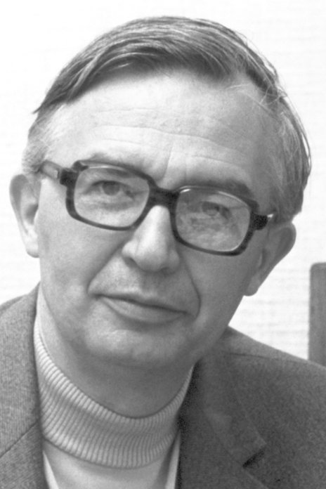
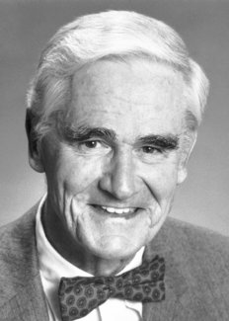
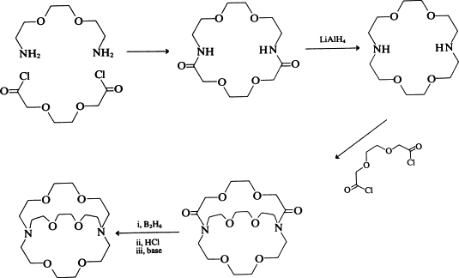
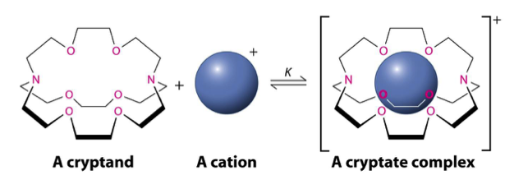
Cryptands or Cryptates or Crypts
1969, Jean-Marie Lehn
1987- Nobel Prize, Donald J. Cram, Jean-Marie Lehn and Charles J. Pedersen for synthesis of high selectivity molecules
their name comes from crypt
encapsulate anions, cations and neutral molecules
crypts contain nitrogen, oxygen and sometimes phosphorus and sulfur atoms
three-dimensional analogues of crown ethers
are more expensive and difficult to prepare, but offer much better selectivity and strength of binding
hydrogen bonds and electrostatic interactions
solvent extraction, phase transfer catalysis, stabilization of uncommon or reactive oxidation states and the promotion of other improbable reactions
Jean-Marie Lehn
cryptands
Donald J. Cram
carcerands
Charles Pedersen
crown ethers
Jean-Marie Lehn, Accounts Of Chemical Research, Volume 11, Number 2, 1978. Cryptates: The Chemistry of Macropolycyclic
Organic chemistry- I (Nature Of Bonding And Stereochemistry) , Module 11: Crown Ethers, Complexes And Cryptands
Luigi Fabbrizzi (Università di Pavia, Italy).(2018) Cryptands and Cryptates

Slide 11
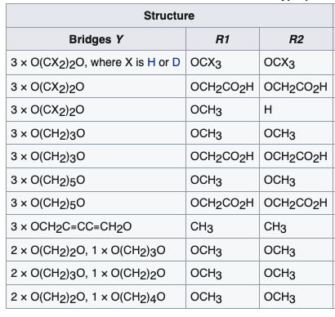
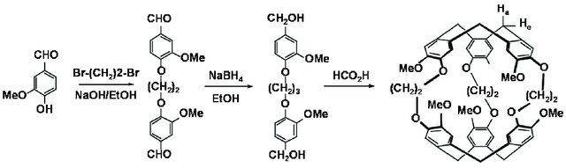
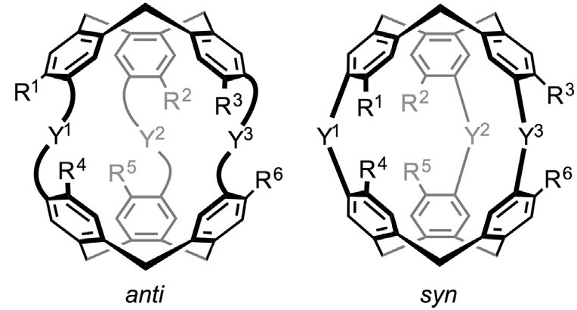
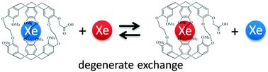
Cryptophanes
Andre Collet and Jacqueline Gabard in 1981
two symmetric cyclotribenzylene (CTB) units connected by three bridges
most cryptophanes exhibit two diastereomeric forms (syn and anti)
suitable for encapsulating many types of small molecules
unique molecular recognition properties
can carry out reactions that would otherwise be difficult to run under normal conditions
storage of hydrogen gas for potential use in fuel cell automobiles
Scheme for degenerate exchange in xenon binding to monoacetic acid cryptophane-A.
The three methods for cryptophane synthesis: (A) template method, (B) two-step method, and (C) capping method.
G. El-Ayle and K Travis Holman, (2017). Cryptophanes
Taratula, P. Aru Hill, Najat S. Khan, Patrick J. Carroll & Ivan J. Dmochowski (2010). Crystallographic observation of 'induced fit' in a cryptophane host–guest model system.

Slide 12
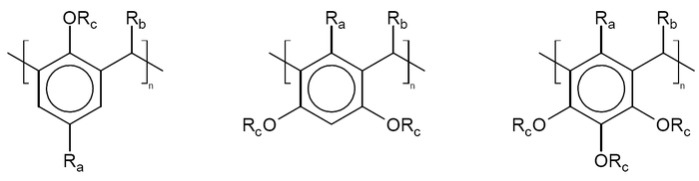
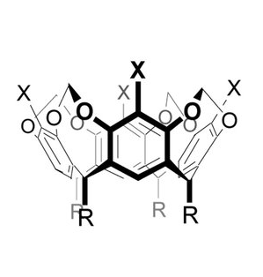
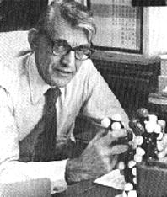
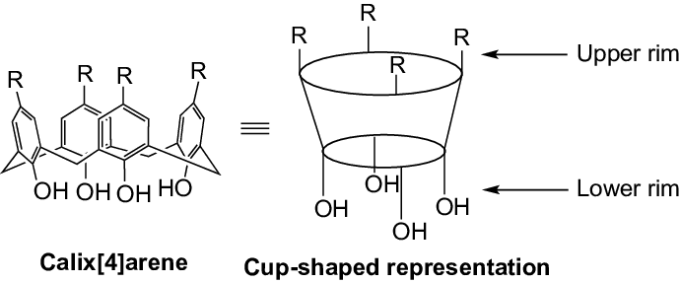
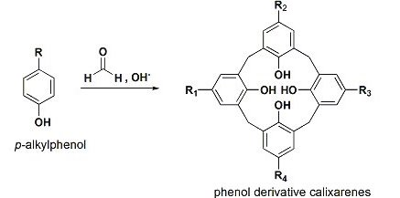
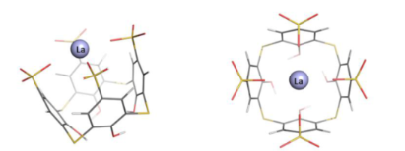
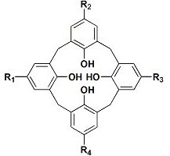
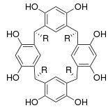
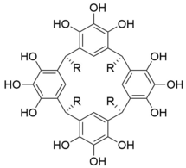
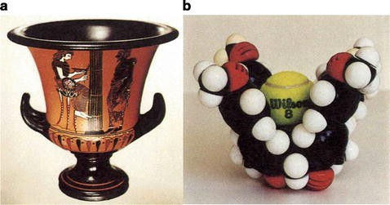
Calixarenes
C. David Gutsche, 1970s
is derived from calix or chalice because this type of molecule resembles a vase and from the word arene that refers to the aromatic building block
a macrocycle or cyclic oligomer based on a hydroxyalkylation product of a phenol and an aldehyde
the aromatic components are derived from phenol, resorcinol, or pyrogallol to give, respectively, calixarenes, resorcinarenes and pyrogallolarenes
hydrophobic cavities that can hold smaller molecules or ions
form complexes with cadmium, lead, lanthanides and actinides
From left to right with n = 4. Calix[4]arene, resorcinol[4]arene, pyrogallol[4]arene.
R_{a} is an alkyl substituent, R_{b} is hydrogen with formaldehyde or phenyl with benzaldehyde, R_{c} is hydrogen in the parent compounds
Calixarenes
Resorcinarenes
Pyrogallolarenes
Ramjee Balasubramanian, Young-Gil Kwon, and Alexander Wei (2007). Encapsulation and Functionalization of Nanoparticles in Crosslinked Resorcinarene Shells
Placido Neri, Jonathan L. Sessler, Mei-Xiang Wang (2016). Calixarenes and Beyond
Notes:
para-tert-butyl substituents

Slide 13
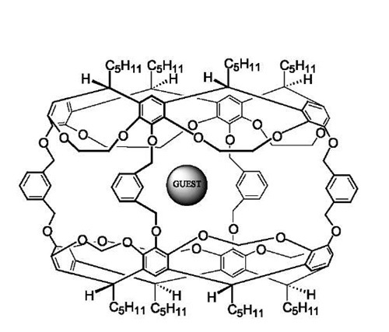
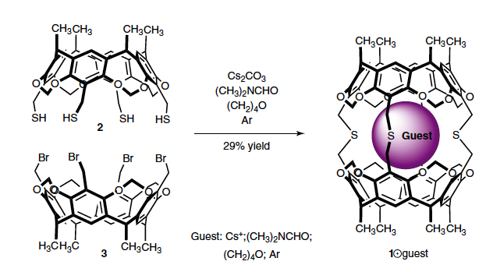
Carcerands
Donald J. Cram, mid 1980s
is derived from the Latin carcer, or prison
entraps its guest so that it will not escape even at high temperatures
the first generation carcerands are based on calixarene hemicarcerands with 4 alkyl substituents on the upper rim and 4 reactive substituents on the lower rim
the complexes formed by a carcerand with permanently imprisoned guests are called carcerplexes
very small molecules, such as H₂, O₂, N₂, or water, may pass
Donald J. Cram
Templated synthesis of carceplex 1guest by fourfold connecting of cavitand 2 and 3 and space-filling model of 1.
Supramolecular Chemistry: From Molecules to Nanomaterials in 2012 by John Wiley & Sons, Ltd
https://newdrugapprovals.org/2014/04/14/carcerand-for-molecular-encapsulation-drug-delivery/

Slide 14
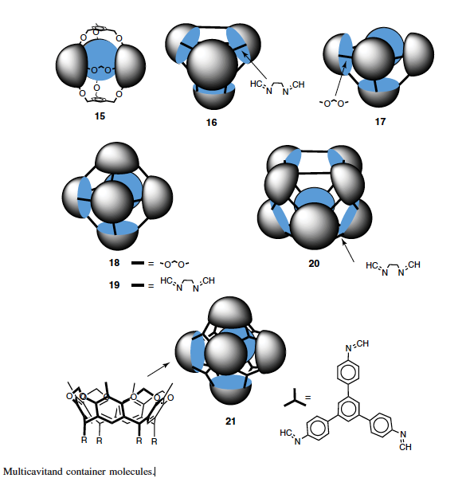
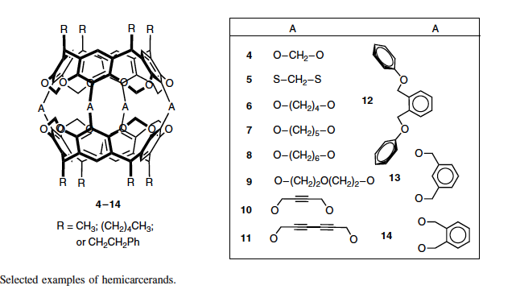
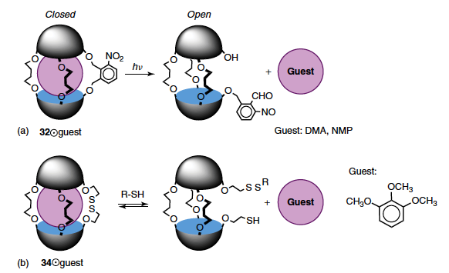
Hemicarcerands
Hemicarcerands allow guests to enter and exit the cavity at high temperatures but will form stable complexes at ambient temperatures
have cavities suitable for the incarceration of guests of a wide range of sizes and shapes starting from molecular gases such as H₂, N₂, O₂, and Xe to molecules as large as C₆₀
even larger multicavitand container molecules have recently been prepared by linking three and up to eight cavitands together
(a) Light-induced guest release in hemicarceplex. (b) Redox-active hemicarceplex guest and mechanism of thiol-triggered guest release.
Supramolecular Chemistry: From Molecules to Nanomaterials in 2012 by John Wiley & Sons, Ltd
https://newdrugapprovals.org/2014/04/14/carcerand-for-molecular-encapsulation-drug-delivery/

Slide 15
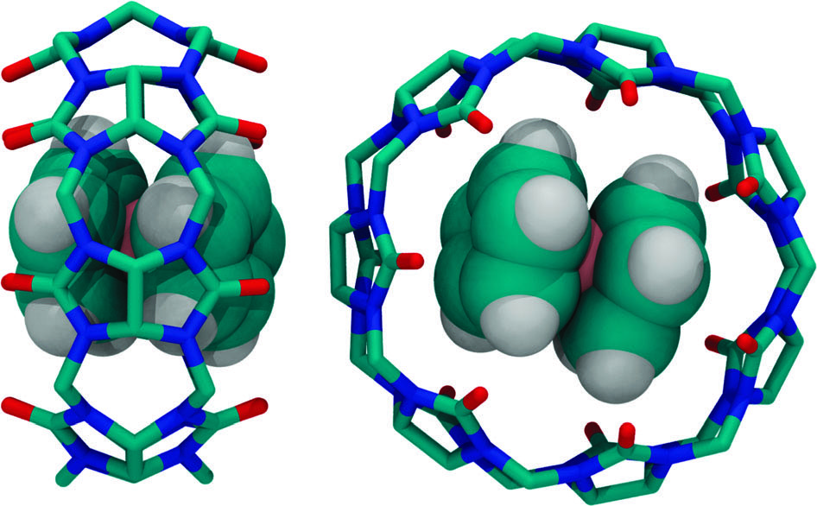
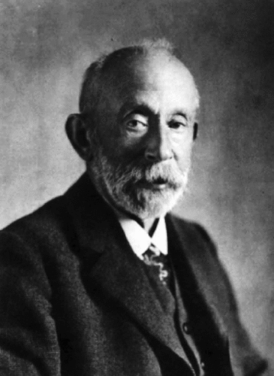
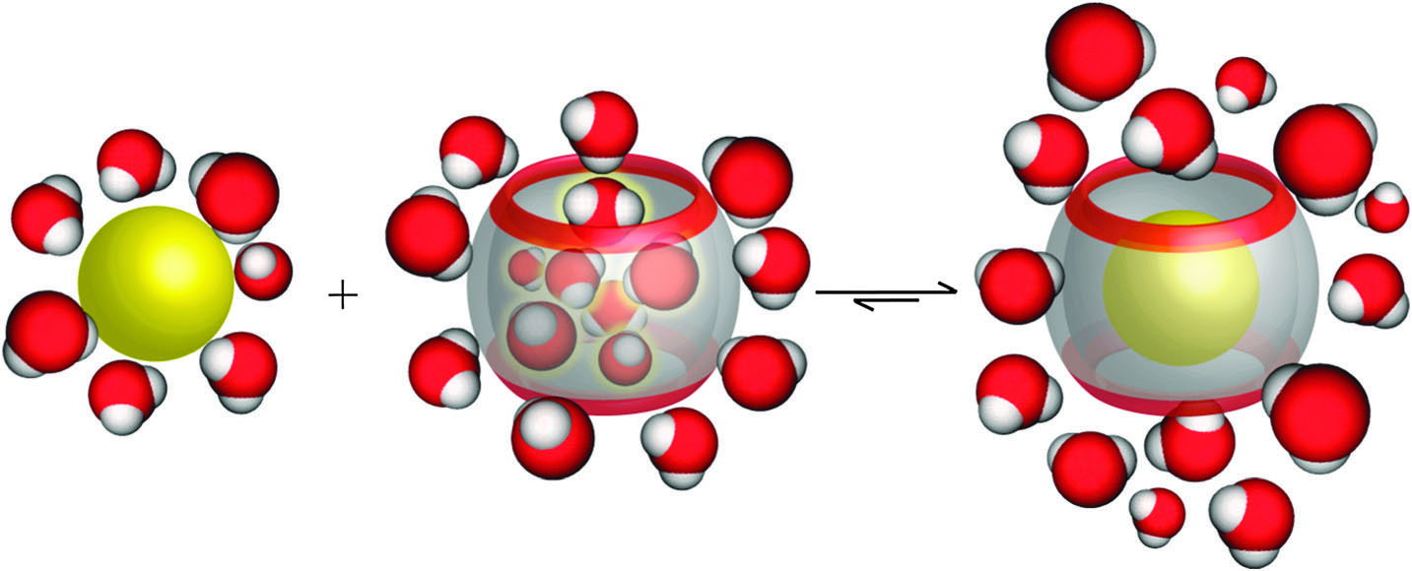
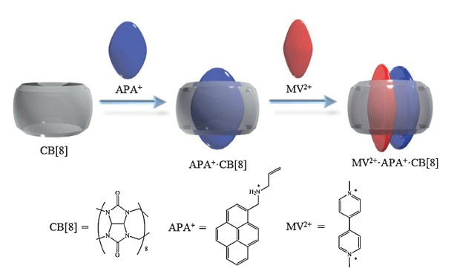
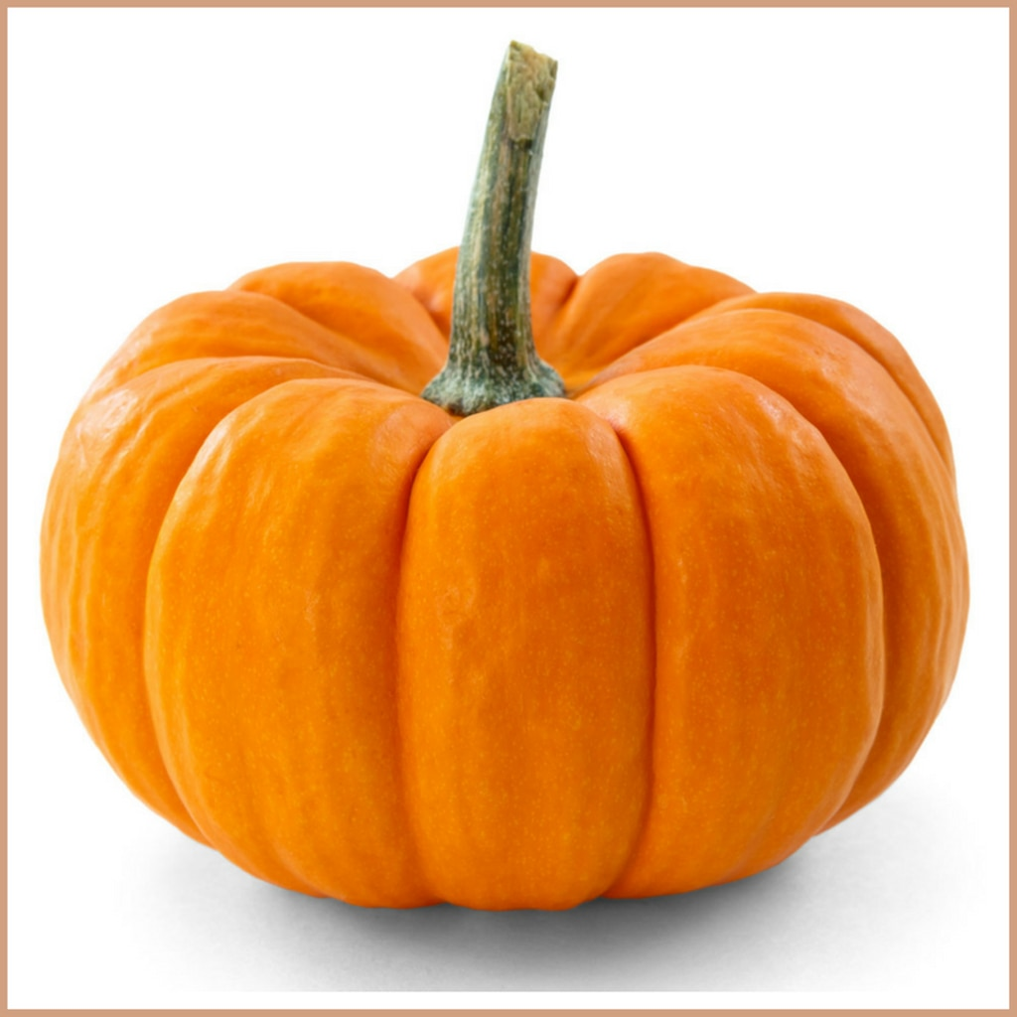
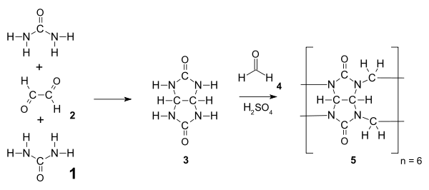
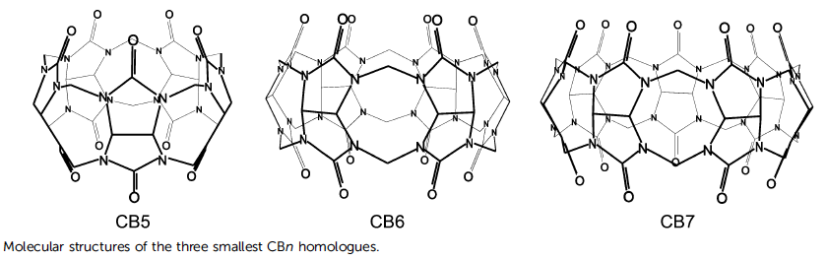
Cucurbiturils
in 1905, Robert Behrend
derived from the resemblance of this molecule with a pumpkin
made of glycoluril (=C₄H₂N₄O₂=) monomers linked by methylene bridges (-CH₂-)
oxygen atoms are located along the edges of the band and are tilted inwards, forming a partly enclosed cavity
able to form stable complexes with various guests, including drug molecules, amino acids and peptides, saccharides, dyes, hydrocarbons, and even proteins
Two different X-ray crystal structures of the complex between ferrocene and CB7
Schematic illustration of the release of high-energy water molecules from the CB7 cavity upon binding of a hydrophobic guest.
Two different X-ray crystal structures of the complex between ferrocene and CB7
Khaleel I. Assaf and Werner M. Nau (2015) Cucurbiturils: from synthesis to high-affinity binding and catalysis
Hao Chen, Hui Yang, Wen-Chao Xu, Ye-Bang Tan.A fluorescent guest used to determinate the effective content of CB[8] and to further detect methyl viologen[J]. Chin. Chem. Lett., 2013,24(09): 857-860

Slide 16
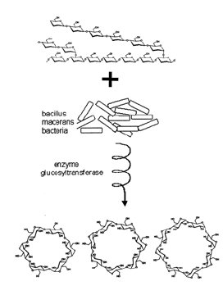



Cyclodextrins
were called "cellulosine" when first described by A. Villiers in 1891
Schardinger identified the three naturally occurring cyclodextrins -α, -β, and –γ
family of cyclic oligosaccharides
nontoxic
prepared by enzymatic treatment of starch
molecular containers for organic, inorganic, organometallic compounds
molecular recognition, delivery systems and complexing agents in the food and drug industries, or for masking of undesired odor and taste
α-cyclodextrin : 6 glucose subunits. β-cyclodextrin: 7 glucose subunits. γ-cyclodextrin: 8 glucose subunits
Crini G., Fourmentin S., Fenyvesi É., Torri G., Fourmentin M., Morin-Crini N. (2018) Fundamentals and Applications of Cyclodextrins. In: Fourmentin S., Crini G., Lichtfouse E. (eds) Cyclodextrin Fundamentals, Reactivity and Analysis. Environmental Chemistry for a Sustainable World, vol 16. Springer, Cham
Cyclodextrins and Their Complexes. Edited by Helena Dodziuk, 2006 WILEY-VCH Verlag GmbH & Co. KGaA, Weinheim

Slide 17




Pillarenes
reported in 2008 by Tomoki Ogoshi
are composed of hydroquinone units linked by methylene bridges at para-positions
exhibit planar chirality
structurally similar to the cucurbiturils and calixarenes
π interactions, cationic-anionic, hydrophobic-hydrophilic, hydrogen-Bond interactions, charge transfer interactions
shape selective catalysis, removal organic pollutants from water
Mahendra Sonawane, Jeroen Jacobs, Joice Thomas, Wim Dehaen, Luc Van Meervelt (2013), Synthesis and Structural Exploration of Disulfide Bridged Pillararene-Like Molecules

Slide 18




Zeolites
originally coined in 1756 by Swedish mineralogist Axel Fredrik Cronstedt
from the Greek ζέω (zéō), meaning "to boil" and λίθος (líthos), meaning "stone”
occur naturally but are also produced industrially on a large scale
are microporous, aluminosilicate minerals commonly used as commercial adsorbents and catalysts
have a porous structure that can accommodate a wide variety of cations, such as Na⁺, K⁺, Ca^{2+,} Mg²⁺ and others
used as ion-exchange beds in domestic and commercial water purification, as catalysts and sorbents, providing precise and specific separation of gases

Slide 19





MOFs
developed from the study of zeolite
consist of both inorganic and organic units
coordinated to organic ligands to form one-, two-, or three-dimensional structures
they are porous
porosity allows the diffusion of guest molecules into their bulk structure. The shape and size of pores govern the shape and size selectivity of the guests to be incorporated
drug‐delivery agents, sensors, storage and separation systems, catalysts
Introductory Chapter: Metal Organic Frameworks (MOFs), By Eram Sharmin and Fahmina Zafar (2016)

Slide 20




Dendrimers
1985 Tomalia and independently by Newkome
comes from δένδρον
the divergent approach and the convergent approach
are globular, size monodisperse macromolecules
symmetric core, an inner shell, and an outer shell
each has biological properties such as polyvalency, self-assembling, electrostatic interactions, chemical stability, low cytotoxicity, and solubility
Dendritic ‘‘unimolecular micelle’’ used for the slow release of indomethacin.
(A) Self-assembled metallodendrimer. (B) Self-assembly of dendrimer by hydrogen-bonding.
Dendritic manganese porphyrin oxidation catalyst.
Jean M. J. Frechet (2002). Dendrimers and supramolecular chemistry
Abbasi, E., Aval, S.F., Akbarzadeh, A. et al. Dendrimers: synthesis, applications, and properties. Nanoscale Res Lett 9, 247 (2014)

Slide 21




Endohedral fullerenes
the first lanthanum C₆₀ complex was discovered in 1985 by Richard Smalley and called La@C₆₀
comes from Greek ένδον + έδρα
arc-discharge or implantation
spherical carbon nanostructures that and have additional atoms, ions, or clusters enclosed within their inner spheres
endohedral metallofullerenes (EMFs). Electrons will transfer from the metal atom to the fullerene cage (extra long electron spin lifetime)
and non-metal doped fullerenes (nEMFs) with nitrogen, phosphorus, and helium
1gr = 150M-300M $
potential of making materials stronger than steal, harder than diamonds, high heat resistance and super conductivity
apply them to atomic clocks, self-driving car
Different approaches to synthesize endohedral fullerenes. (i) Encapsulation during the fullerene formation, such as in laser-ablation or arc-discharge methods; main method for endohedral metallofullerenes. (ii) Encapsulation into already available empty fullerene; typical variants are implantation (through ion beam or high pressure-high temperature treatment) and molecular surgery (encapsulation is achieved in a series of chemical reactions “opening” and then “closing” the carbon cage); these approaches are applied for the synthesis of non-metal and alkali-metal endohedral fullerenes.
Periodic Table of endohedral elements describing the possibility to encapsulate different elements into carbon cages and suitable methods of synthesis for corresponding endohedral fullerenes .

Slide 22

Applications
Drug delivery
Photosensitizing
Toxic waste removal
Catalysis
Isolation of unstable compound
Adsorption of liquids to solid state
Gas storage
Molecular recognition and sensing
Separation and storage
Enzyme like molecular recognition
Controlled reactions
Mickey Vinodh, Fatemeh H. Alipour, Abdirahman A. Mohamod and Talal F. Al-Azemi (2012) Molecular Assemblies of Porphyrins and Macrocyclic Receptors: Recent Developments in Their Synthesis and Applications
Chao Liu, Kunhui Liu, Chiming Wang, Heyuan Liu, Hailong Wang, Hongmei Su, Xiyou Li, Banglin Chen & Jianzhuang Jiang, (2020). Elucidating heterogeneous photocatalytic superiority of microporous porphyrin organic cage
Ömer Güngör (2019) Efficient removal of carcinogenic azo dyes by novel pyrazine-2-carboxylate substituted calix[4, 8]arene derivatives, Supramolecular Chemistry, 31:12, 776-783
Hiroaki Kitagishi and Saika Minegishi Iron(II)porphyrin–Cyclodextrin Supramolecular Complex as a Carbon Monoxide-Depleting Agent in Living Organisms.

Slide 23


Applications
Drug delivery
Photosensitizing
Toxic waste removal
Catalysis
Isolation of unstable compound
Adsorption of liquids to solid state
Gas storage
Molecular recognition and sensing
Separation and storage
Enzyme like molecular recognition
Controlled reactions
Synthesis of tubular porphyrin organic cage. The synthetic route of PTC-1(2H) includes Suzuki–Miyaura cross-coupling between 5-bromoisophthalaldehyde and 5,15-bis[4-(4,4,5,5-tetramethyl-1,3,2-dioxaborolan-2-yl)phenyl]porphyrin (H2BTPP) together with imine condensation reaction of enantiomerically pure cyclohexanediamine with 5,15-di[3’,5’-diformyl-(1,1’-biphenyl)]porphyrin (H2DBPP).
Single crystal structure of molecular organic cage (R)-PTC-1(2H).
Mickey Vinodh, Fatemeh H. Alipour, Abdirahman A. Mohamod and Talal F. Al-Azemi (2012) Molecular Assemblies of Porphyrins and Macrocyclic Receptors: Recent Developments in Their Synthesis and Applications
Chao Liu, Kunhui Liu, Chiming Wang, Heyuan Liu, Hailong Wang, Hongmei Su, Xiyou Li, Banglin Chen & Jianzhuang Jiang, (2020). Elucidating heterogeneous photocatalytic superiority of microporous porphyrin organic cage
Ömer Güngör (2019) Efficient removal of carcinogenic azo dyes by novel pyrazine-2-carboxylate substituted calix[4, 8]arene derivatives, Supramolecular Chemistry, 31:12, 776-783
Hiroaki Kitagishi and Saika Minegishi Iron(II)porphyrin–Cyclodextrin Supramolecular Complex as a Carbon Monoxide-Depleting Agent in Living Organisms.

Slide 24


Applications
Drug delivery
Photosensitizing
Toxic waste removal
Catalysis
Isolation of unstable compound
Adsorption of liquids to solid state
Gas storage
Molecular recognition and sensing
Separation and storage
Enzyme like molecular recognition
Controlled reactions
Mickey Vinodh, Fatemeh H. Alipour, Abdirahman A. Mohamod and Talal F. Al-Azemi (2012) Molecular Assemblies of Porphyrins and Macrocyclic Receptors: Recent Developments in Their Synthesis and Applications
Chao Liu, Kunhui Liu, Chiming Wang, Heyuan Liu, Hailong Wang, Hongmei Su, Xiyou Li, Banglin Chen & Jianzhuang Jiang, (2020). Elucidating heterogeneous photocatalytic superiority of microporous porphyrin organic cage
Ömer Güngör (2019) Efficient removal of carcinogenic azo dyes by novel pyrazine-2-carboxylate substituted calix[4, 8]arene derivatives, Supramolecular Chemistry, 31:12, 776-783
Hiroaki Kitagishi and Saika Minegishi Iron(II)porphyrin–Cyclodextrin Supramolecular Complex as a Carbon Monoxide-Depleting Agent in Living Organisms.

Slide 25

Applications
Drug delivery
Photosensitizing
Toxic waste removal
Catalysis
Isolation of unstable compound
Adsorption of liquids to solid state
Gas storage
Molecular recognition and sensing
Separation and storage
Enzyme like molecular recognition
Controlled reactions
Mickey Vinodh, Fatemeh H. Alipour, Abdirahman A. Mohamod and Talal F. Al-Azemi (2012) Molecular Assemblies of Porphyrins and Macrocyclic Receptors: Recent Developments in Their Synthesis and Applications
Chao Liu, Kunhui Liu, Chiming Wang, Heyuan Liu, Hailong Wang, Hongmei Su, Xiyou Li, Banglin Chen & Jianzhuang Jiang, (2020). Elucidating heterogeneous photocatalytic superiority of microporous porphyrin organic cage
Ömer Güngör (2019) Efficient removal of carcinogenic azo dyes by novel pyrazine-2-carboxylate substituted calix[4, 8]arene derivatives, Supramolecular Chemistry, 31:12, 776-783
Hiroaki Kitagishi and Saika Minegishi Iron(II)porphyrin–Cyclodextrin Supramolecular Complex as a Carbon Monoxide-Depleting Agent in Living Organisms.

Slide 26
Applications
Drug delivery
Photosensitizing
Toxic waste removal
Catalysis
Isolation of unstable compound
Adsorption of liquids to solid state
Gas storage
Molecular recognition and sensing
Separation and storage
Enzyme like molecular recognition
Controlled reactions
Supramolecular Complex Hemo CD That Is Composed of the Cyclodextrin Dimer (Py₃CD) and Fe(II)TPPS
Mickey Vinodh, Fatemeh H. Alipour, Abdirahman A. Mohamod and Talal F. Al-Azemi (2012) Molecular Assemblies of Porphyrins and Macrocyclic Receptors: Recent Developments in Their Synthesis and Applications
Chao Liu, Kunhui Liu, Chiming Wang, Heyuan Liu, Hailong Wang, Hongmei Su, Xiyou Li, Banglin Chen & Jianzhuang Jiang, (2020). Elucidating heterogeneous photocatalytic superiority of microporous porphyrin organic cage
Ömer Güngör (2019) Efficient removal of carcinogenic azo dyes by novel pyrazine-2-carboxylate substituted calix[4, 8]arene derivatives, Supramolecular Chemistry, 31:12, 776-783
Hiroaki Kitagishi and Saika Minegishi Iron(II)porphyrin–Cyclodextrin Supramolecular Complex as a Carbon Monoxide-Depleting Agent in Living Organisms.

Slide 27
Thank you for your attention !

